Slide 1
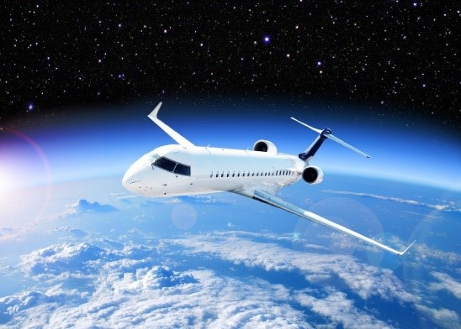
Final Presentation
Flyin’ High
PM: Victoria Condos
Victoria.r.condos@lmco.com

Slide 2
Outline
Our Drone: The Falcon Light
Project Plan & Budgeting
WBS
Team Structure
EVM Report
Systems Overview
CONOPS
Annotated Diagram
Software Overview
FFBDs
Pseudo Code
Hardware Overview
Trade Studies
Physical Architecture
Test Plans
Behavioral
Non-Behavioral
Final Thoughts

Slide 3
Our Drone: The Falcon Light

Slide 4
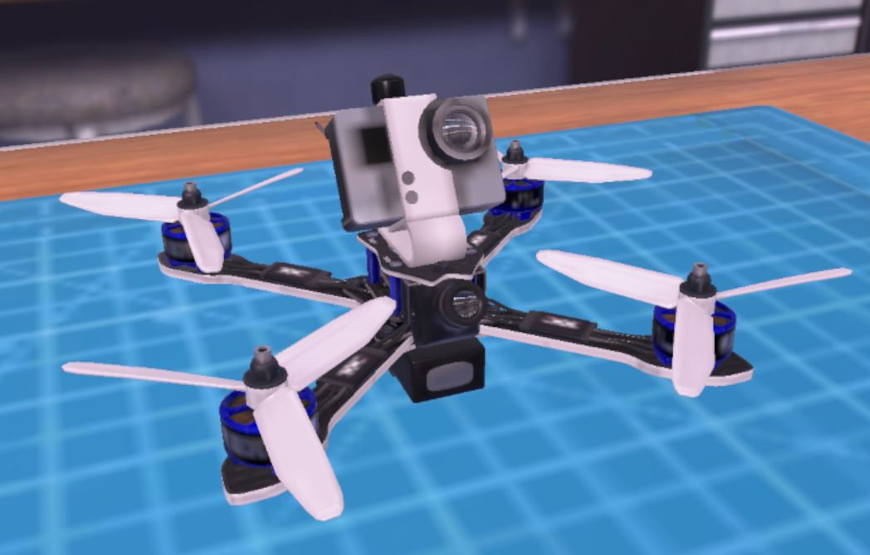
The Falcon Light

Slide 5
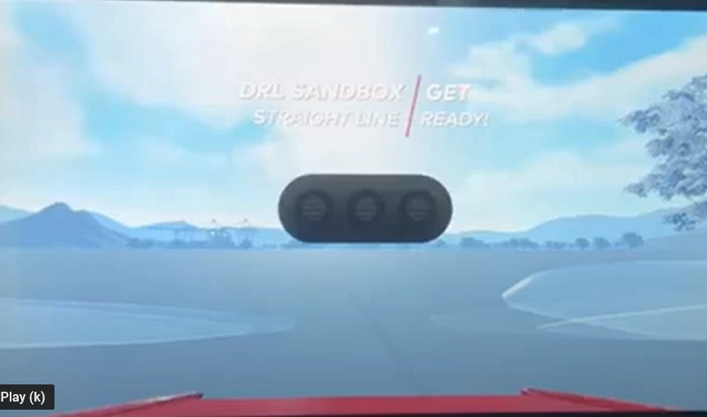
Falcon Light Flight Reel

Slide 6
Mission/ Thesis
Our Mission… Fly High and Prosper!
Based on Levitating Machines Inc.’s vision of winning with style, team Flyin’ High will develop Falcon Light, a drone that will satisfy all of LM’s requirements. The Falcon Light’s unique system includes the ideal aerodynamic performance created by balancing speed and maneuverability to enhance the pilot’s racing abilities. With a balanced design and a user- friendly controller, we are confident that Falcon Light will be meeting racing expectations for years to come.

Slide 7
Project Plan & Budgeting

Slide 8
Organizational Chart
Project Manager Victoria C
Software Manager Steve P
Hardware Manager Maria E
Testing Lead Joe B
Deputy Project Manager Isabella R
Lead Pilot Joe B
Secondary Pilot Isabella R

Slide 9
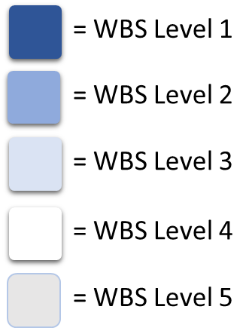
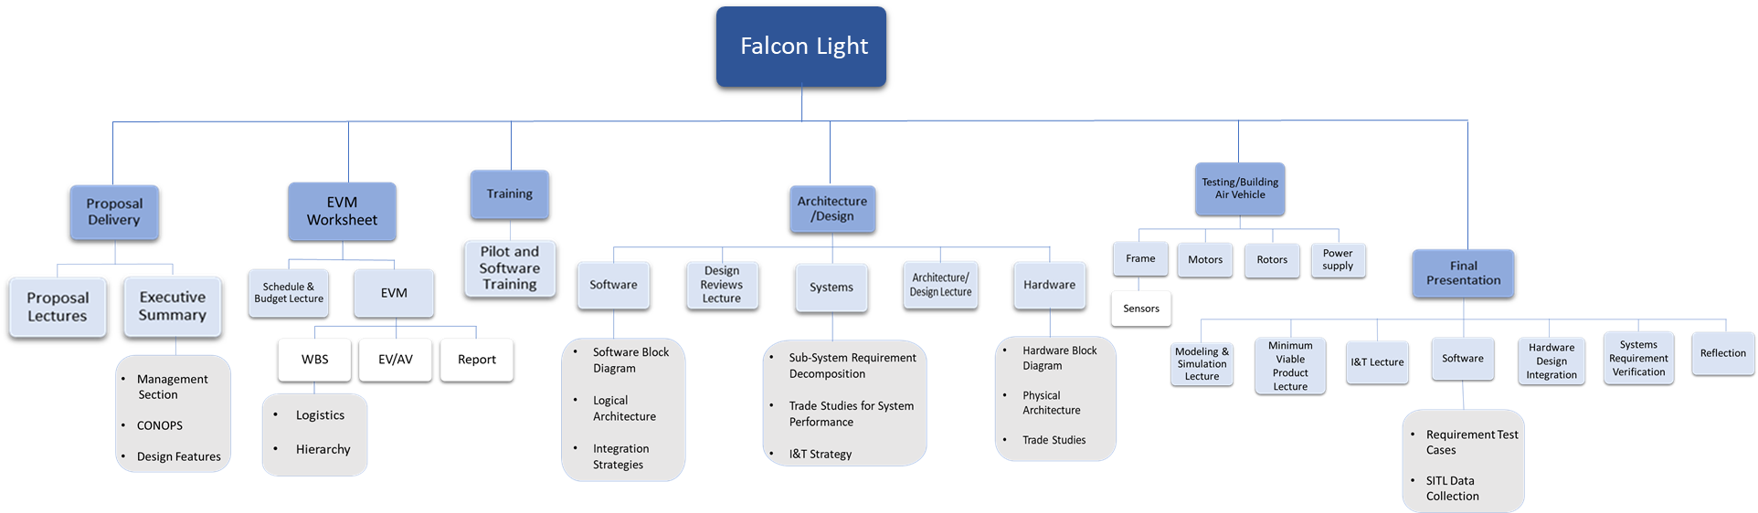
WBS

Slide 10
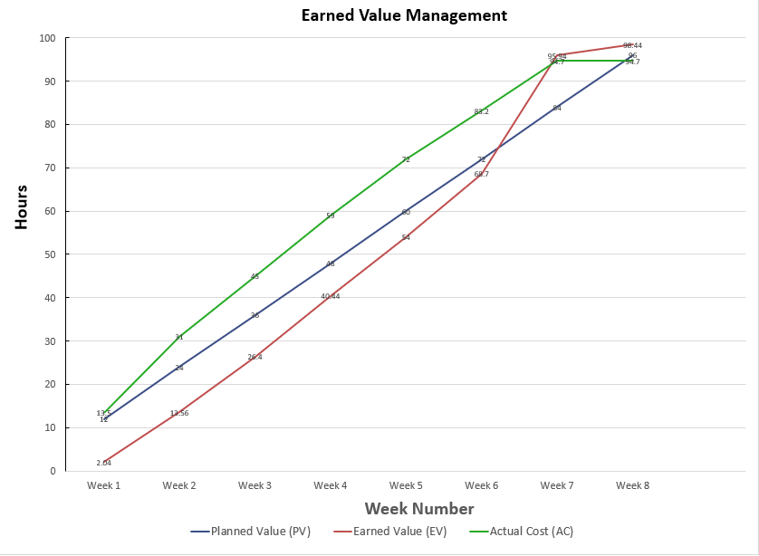
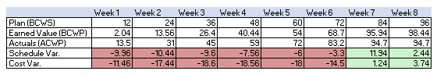
Budget Report Overview

Slide 11
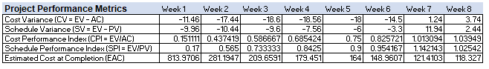
Project Performance Metrics

Slide 12
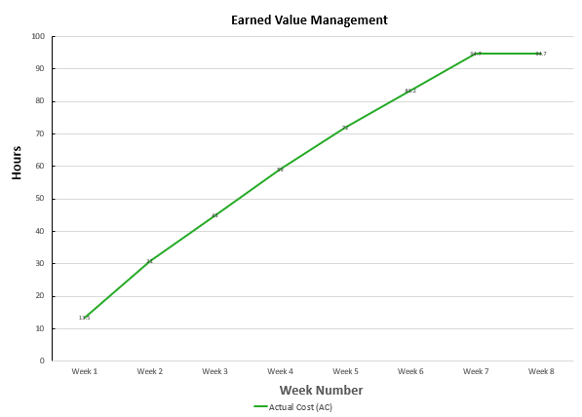
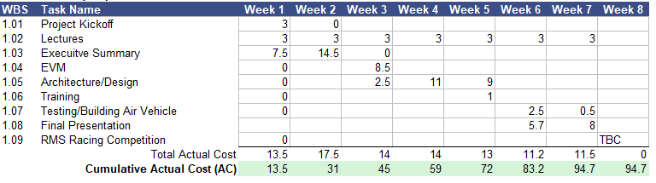
Actual Cost

Slide 13
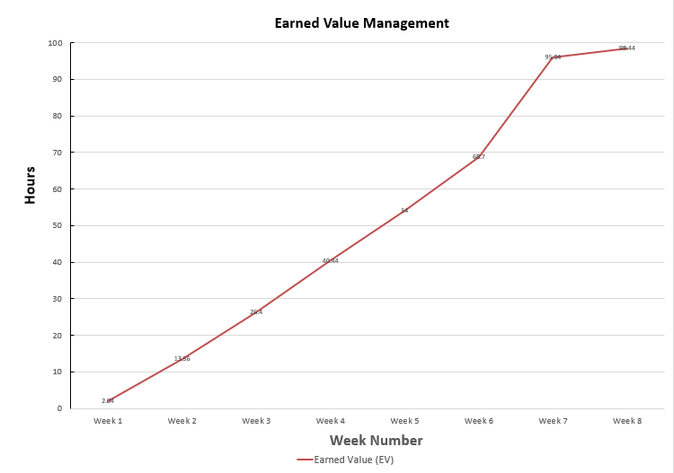
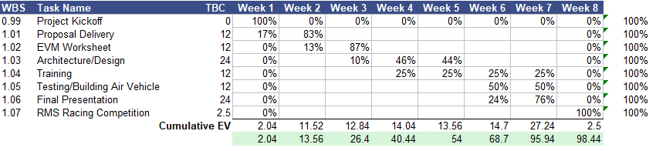
Earned Value

Slide 14
Systems Overview

Slide 15
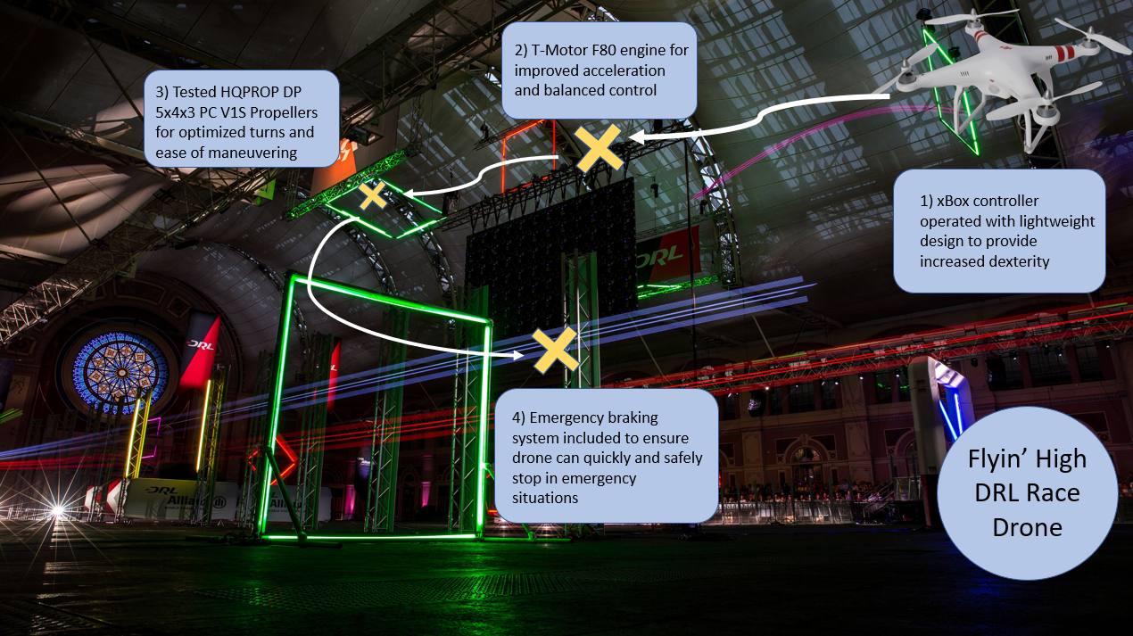
Conops

Slide 16
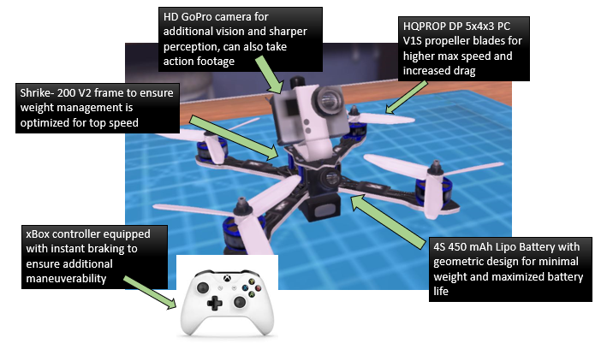
functional annotated Concept Diagram

Slide 17
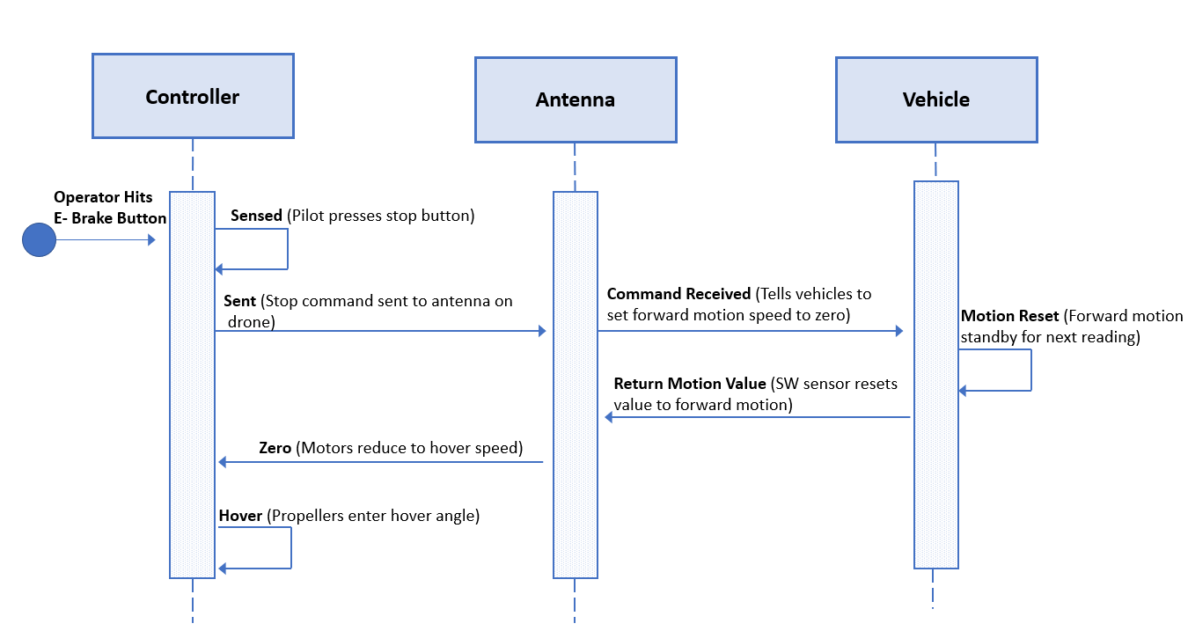
sequence diagram: Emergency Braking System

Slide 18
Software Overview

Slide 19
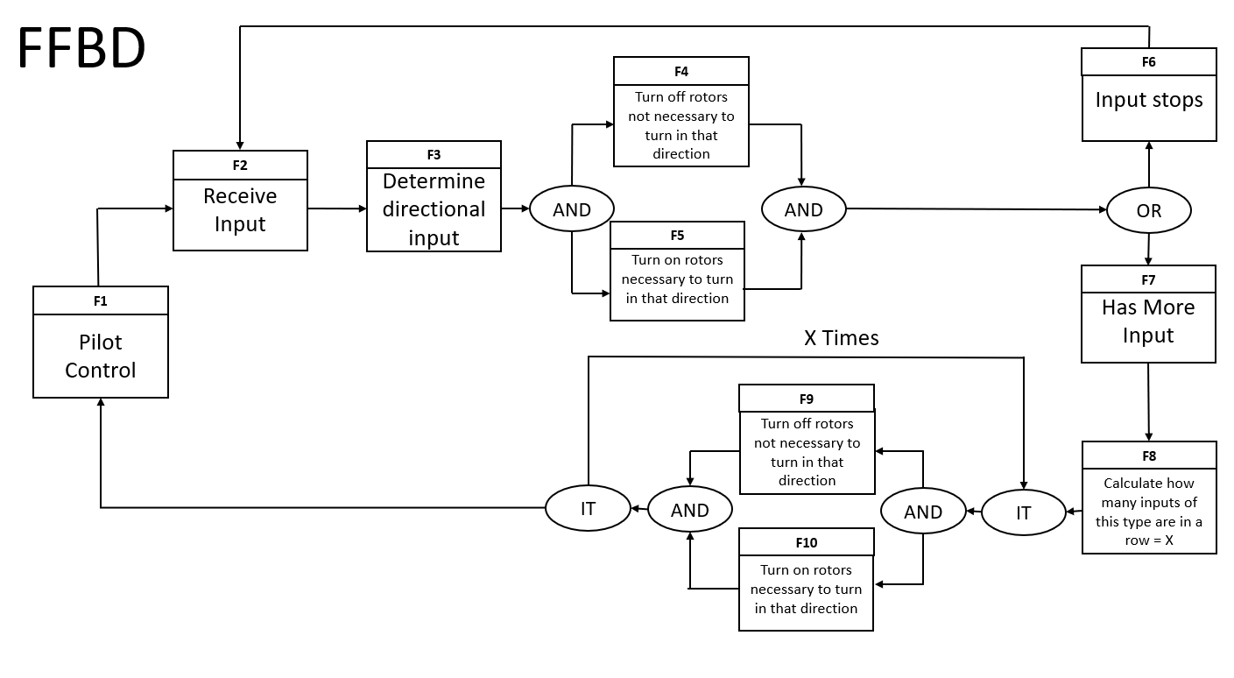
Functional Flow block diagram: Steering

Slide 20
IDEf0-A0: F9 Turn On Rotors
Constraints
Course obstacles and boundaries
Turn on Rotors
Inputs
Outputs
Signal to test rotors
Signal that rotors function
A0.
Radio signals
Radio function code
Resources

Slide 21
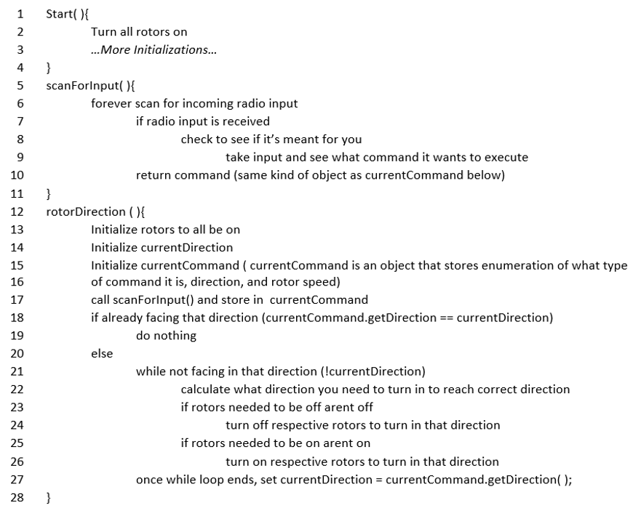
Pseudo code: F9 & F10 Turn On/Off Rotors Not Necessary To Turn In That Direction
The Start function is meant to initialize the motors and rotors so that flight can begin. The scan for input function is there to receive input from the pilot so that commands can be executed. This is necessary for the drone to function manually. It can function without this system, however it would need to be replaced with an AI of some capacity to determine what to do in place of the pilot. The Rotor direction method is to ensure that the drone is moving the way its supposed to, which is why the initialization occurs each time. Then it works with the input received to determine what motors and propellers need to be turned off in order to ensure that the drone turns the correct way.

Slide 22
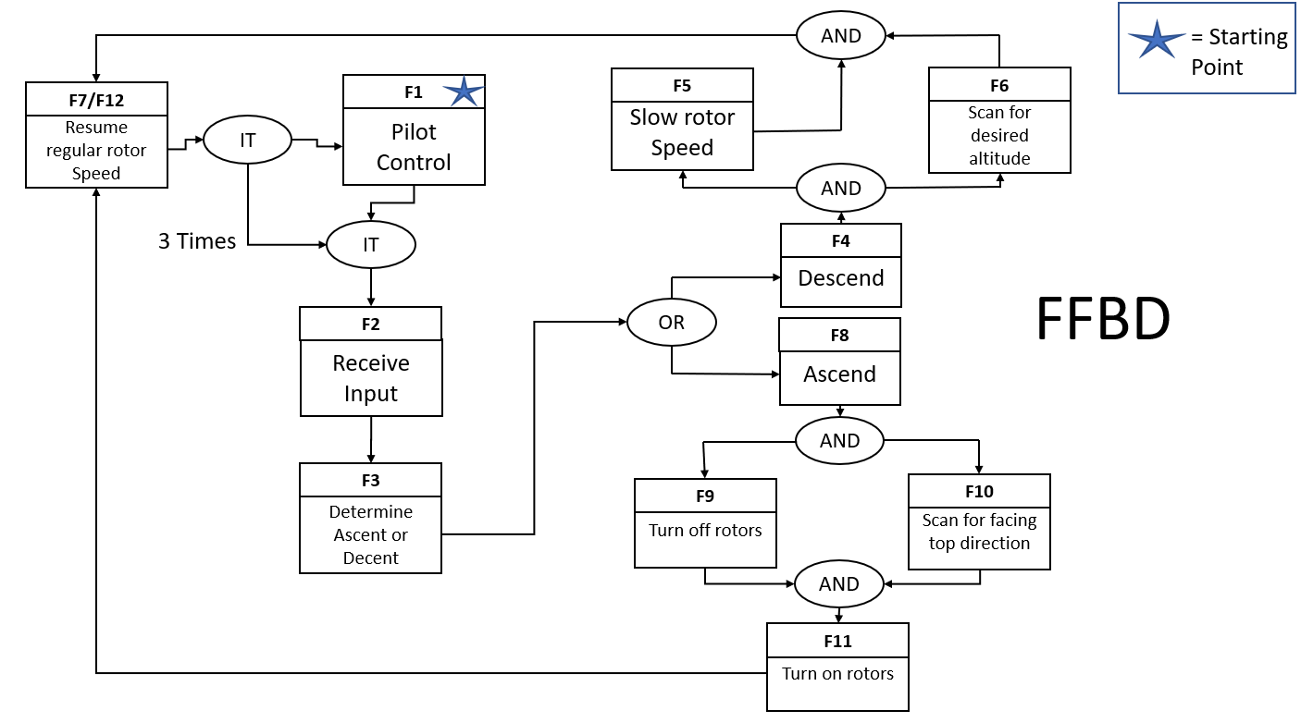
Functional Flow block diagram: Ascend-Descend

Slide 23
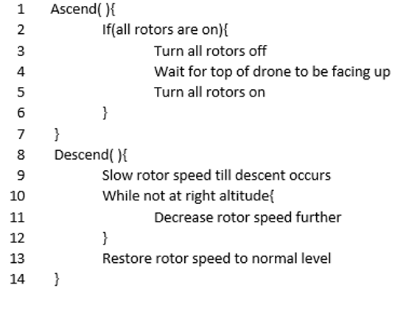
Pseudo Code: F3 Determine Ascent-Decent
These are to adjust the height of the drone to help with completion of the course. The ascend method turns off the rotors so that the drone will slightly fall while the top of the drone's direction adjusts so that when the rotors turn back on, the drone will ascend upward. The Descend method will decrease the rotor speed so that it will loose height, causing the drone to descend.

Slide 24
Hardware Overview

Slide 25
Design Description
Physical Hardware | Subsystem | Justification
4S 450 mAh Lipo Battery | Propulsion System | Lightweight battery with sufficient battery life for the drone to complete 3 laps. Also generates high top speed along with large amounts of thrust.
Shrike-200 V2 | Hardware System | Lightweight 5’’ frame that helps increase the drones top speed. This frame also produces less drag compared to other options.
xBox Controller | Navigation System | The controller is what the pilot uses to control the drones flight. The laptop communicates with the drone via the transmitter and provides the pilot with navigation.
HQPROP DP 5x4x3 PC V1S | Propulsion System | The blades spin creating thrust to cause the drone to lift. Two blades will spin clockwise and the other two will spin counterclockwise to help with balance.
T-Motor F80 | Propulsion System | Strong motor that generates a lot of thrust for takeoff. Also, generates a lot of torque for the blades and has little power consumption.
E Brake | Hardware System | Emergency brake button that helps the pilot take control over the drone in certain situations. Button is attached to the pilots controller.
GoPro HD Camera | Hardware System | The HD Camera will allow us to record previous races as well as take pictures while in the air. The camera is also still able to operate if fallen in water or at a high altitudes.

Slide 26
Trade study #1 – DRONE Frame TYPE SELECTION
Selection Criteria | Definition
Thrust | Drone’s ability to create a lift force for vertical ascend
Weight | Total weight of drone
Durability | Drone’s ability to withstand wear, collisions, longer flight times
Complexity | Total parts and detail level of drone’s frame design/architecture
Speed | Drone’s possible top speed (KPH) and its ability to accelerate to this speed using rotor RPM and torque
Trade Title |  |  | Drone Frame Selection
ID | Weight | Selection Criteria (Decision Drivers) | Grading Scale (1-5) | A: Flaco 5’’ | B: Chameleon | C: Shrike-200 V2
1 | 1 | Thrust | 5 | 2 | 3 | 5
2 | 2 | Weight | 5 | 3 | 2 | 3
3 | 3 | Durability | 5 | 3 | 2 | 4
4 | 4 | Complexity | 5 | 3 | 4 | 3
5 | 5 | Speed | 5 | 5 | 2 | 4
Max Score: 25 | A | B | C
Trade Study Score: | 51 | 42 | 55
Recommended Solution: | Shrike-200 V2
Notes:
A: Flaco 5”
B: Chameleon
C: Shrike-200 V2

Slide 27
Drone frame type grading scale
Score (1= Worst; 5 = Best) | Thrust (g) | Weight (g) | Durability (RPM) | Complexity (drag in Ns/m) | Speed (top speed in kph)
1 | Less than 4000g | 700g-799g | Less than 30,000 RPM | Greater than 4 Ns/m | Less than 90 kph
2 | 4000g-4999g | 600g-699g | 31,000 RPM – 33,999 RPM | 3 Ns/m – 4 Ns/m | 90 kph – 119 kph
3 | 5000g-6499g | 500g-599g | 34,000 RPM - 37,999 RPM | 2 Ns/m – 2.99 Ns/m | 120 kph – 149 kph
4 | 6500g-8000g | 400g-499g | 38,000 RPM – 40,000 RPM | 1.99 Ns/m – 1 Ns/m | 150 kph – 180 kph
5 | Greater than 8000g | Less than 400g | Greater than 40,000 RPM | Less than 1 Ns/m | Greater than 180 kph
Notes:
A: Flaco 5”
B: Chameleon
C: Shrike-200 V2

Slide 28
Drone frame type Actual Values
Frame Type | Thrust (g) | Weight (g) | Durability (RPM and Peak Operating Temp) | Complexity (drag) | Speed (top speed in kph)
Flaco 5” (A) | 4601 g | 515 g | 34154 RPM | 2.67 Ns/m | 184 kph
Chameleon (B) | 5184 g | 626 g | 31874 RPM | 1.63 Ns/m | 108 kph
Shrike-200 V2 (C) | 8057 g | 540 g | 39222 RPM | 2.21 Ns/m | 150 kph
Notes:
A: Flaco 5”
B: Chameleon
C: Shrike-200 V2

Slide 29
Trade study #1 – drone frame type selection
This trade study was used to help select which frame type in the DRL Software is best for enabling Team Flyin’ High’s drone to meet the customer needs and requirements of this project. Selecting a frame type will put this trade study under the Hardware subsystem of our design. The following slide establishes our selection criteria and their definitions, the grading scale, and final scores. We scored three drone frame types listed as A,B, and C on our diagram. These letters represent in order the Flaco 5”, Chameleon, and Shrike-200 V2 frames.
For this study, we have chosen frame types that are all 5” quadcopters, per the customer requirements. The grading scale scores from 1 to 5, with 5 being the best score, indicating the frame type presents the best conditions for helping the drone complete 3 laps of the default course and win the race. Thrust, weight, and top speed were all properties provided to us directly by the software. When grading on these criteria, we looked for a lightweight frame, a high top speed, and a powerful thrust force for liftoff. We strived for less complexity within the physical design to reduce drag force. Lastly, we graded durability based on the overall properties provided to us by the DRL software. A frame with strong thrust, low drag, high top speed and RPM of rotors, and highest peak temperature contributed to determining durability final scores.
Notes:
A: Flaco 5”
B: Chameleon
C: Shrike-200 V2

Slide 30
Trade study #2 – Lipo Battery SELECTION
Selection Criteria | Definition
Cost | The total cost of the battery
Weight | Total weight added to the quadcopter due to the battery
Top Speed | The maximum speed the Lipo battery will allow the quadcopter to go
Battery life | How long the battery will last from full charge to dead
Thrust | The total increase of thrust force caused by the Lipo battery
Trade Title |  |  | Lipo Battery Selection
ID | Weight | Selection Criteria (Decision Drivers) | Grading Scale (1-5) | A: 5S 850 mAh | B: 3S 1550 mAh | C: 4S 450 mAh
1 | 1 | Battery life | 5 | 3 | 5 | 2
2 | 2 | Thrust | 5 | 5 | 2 | 4
3 | 3 | Cost | 5 | 3 | 4 | 4
4 | 4 | Top Speed | 5 | 5 | 2 | 5
5 | 5 | Weight | 5 | 3 | 3 | 4
Max Score: 75 | A | B | C
Trade Study Score: | 57 | 44 | 62
Recommended Solution:
4S 450 mAh Lipo Battery
Notes:
A: Flaco 5”
B: Chameleon
C: Shrike-200 V2

Slide 31
Lipo Battery Grading Scale
Score (1 = Worst; 5 = Best) | Cost (USD) | Weight (g) | Top Speed (kph) | Battery Life (mAh) | Thrust (g)
1 | $41+ | 201g+ | Less than 125 kph | Less than 450 mAh | Less than 2000g
2 | $31 - $40 | 151g – 200g | 125 kph – 150 kph | 450 mAh | 2000g -4000g
3 | $20 - $30 | 101 – 150g | 150 kph – 175 kph | 850 mAh | 4000g – 6000g
4 | $10 - $19 | 51g – 100g | 175 kph – 200 kph | 1000 mAh | 6000g – 8000g
5 | $0 - $9 | 1g – 50 g | Greater than 200 kph | 1550 mAh | Greater than 8000g

Slide 32
Lipo Batter Actual Values
Lipo Battery Options
5s 850 mAh (A)
3s 1550 mAh (B)
4s 450 mAh (C)
Cost | Weight | Top Speed | Battery Life | Thrust
$20.49 | 132g | 192 kph | 450 mAh | 8096 g
$18.12 | 128 g | 133 kph | 1550 mAh | 3908 g
$11.99 | 65 g | 175 kph | 450 mAh | 6602 g

Slide 33
Trade Study #2 - Lipo Battery Type
We used this Trade Study to select which Lipo Battery is the best to achieve customer requirements. This trade study falls under the Propulsion Subsystem. Options A, B, and C represent a 5s 850 mAh Lipo battery, 3s 1550 mAh Lipo battery, and a 4s 450 mAh battery respectively.
For choosing a battery we looked at 5 criteria, cost, weight, top speed, thrust and battery life. Our team looked for a lightweight battery to minimize the quadcopters total weight. We also looked for a sufficient amount of thrust for a quick take off. Battery life was included to ensure that the quadcopter had enough power to complete three laps. Having a high top speed will help the pilot take advantage of straightaways. We also wanted an affordable battery that would output good results from the other four criteria.

Slide 34
Flyin’ high physical architecture
Flyin’ High Drone
Propulsion System
Hardware System
Navigation System
T-Motor F80
HQPROP 5x4x3 PC V1S Propellers
Shrike-200 V2 Frame
E brake
Xbox Controller (connects to laptop)
4S 450 MAh Lipo Battery
GoPro CameraHD
XBox Controller Button

Slide 35
Test Plans

Slide 36
Behavioral Test Plan
OR #/DR # | Requirement | Abstract name | Test # | Test Method | Test Facilities | Entry Condition | Exit Condition
OR 1/DR 4 | The Drone shall change speed. | Agility | TR. 1 | Test Procedure: The pilot changes the quadcopter’s speed on a Manhattan Project course. | Computer, Pilot, xbox controller, Manhattan Project course, completed quadcopter. | The pilot flies the completed drone prototype on a Manhattan Project course. | The pilot successfully changes speeds from 100 kph to 175 kph.
OR 3/DR 15 | The drone shall have emergency braking. | Safety | TR. 2 | Test Procedure: The pilot will enable the E brake on Manhattan Project Course. | Computer, Pilot, xbox controller, Manhattan Project course, completed quadcopter. | The pilot flies the completed drone prototype on a Manhattan Project course and enables E brake during flight. | The pilot successfully enables E brake and stops the drone mid flight.
OR 3/DR 11 | The long-distance receiver shall operate on a range of 0-1000m. | Range | TR. 3 | Test Procedure: The pilot will fly the drone on Manhattan Project Course. | Computer, Pilot, xbox controller, Manhattan Project course, completed quadcopter. | The pilot flies the completed drone prototype on a Manhattan Project course. | The pilot successfully completes the course without flying out of receiver range.
OR 4/DR 20 | The propellers shall produce a maximum heat of 450mAh. | Heat Output | TR. 4 | Test Procedure: The pilot will fly drone for extended period of time to ensure no over heating occurs. | Computer, Pilot, xbox controller, Manhattan Project course, completed quadcopter. | The pilot flies the completed drone prototype on a Manhattan Project course. | The pilot successfully flies the drone without the 450 mAh power supply overheating.

Slide 37
Non-Behavioral Test Plan
OR#/DR# | Requirement | Abstract Name | Test # | Test Method | Verification Method (A, I, D, T) | Test Facilities | Entry Condition | Exit Condition
OR 3/ DR 12 | The drone shall be able to operate successfully for 3 laps of the chosen drone course. | Reliability | TP.5 | Test Procedure: The pilot will race the drone through 3 laps of multiple courses, at intermediate level, focusing on the Manhattan Project courses. | T | Pilot operating in DRL Software, using an Xbox controller plugged into the laptop | Completed prototype in DRL | The drone is able to race through 3 laps of various drone courses on DRL without failure or damage to drone body.
OR 3/ DR 15 | The drone shall use an E-brake for automatic braking in an emergency situation that could risk damaging the drone without an immediate stop. | Safety | TP. 6 | Test Procedure: The pilot will race the drone at intermediate level through a Manhattan Project course. The pilot will practice racing at a high speed (close to drone top speed) and then enabling E brake. | I | Pilot operating in DRL Software, using an Xbox controller plugged into laptop | Completed prototype in DRL | The drone is able to race at a high speed and successfully enable E brake to complete an emergency stop. The drone will come to a complete stop within 2 seconds of E brake activation. Drone is not damaged in any way due to emergency stop.

Slide 38
Final Thoughts…

Slide 39
Reflection
“The DRL project was a great way to connect with interns in different departments, and it helped me develop my time management skills” – Victoria
“During this remote internship, the DRL project allowed me to meet other interns with various backgrounds and learn to collaborate with them. This project was also a way for me to learn and understand the process LM uses for proposing a design to a customer, effectively budgeting, and meeting customer requirements.” –Maria
“Thanks to the weekly lectures and deliverables I feel I have a greater understanding about the LM Program lifecycle. This project also helped me gain experience in various departments such as Hardware, Software, and Systems.” -Joe
“Working on the DRL project throughout the internship has been a great way to connect with other interns, as well as learn about the full lifecycle of a product, and to see how all the different areas of work interact.” –Steven
“What I love most from the DRL project is working with a team to make really informative deliverables. Looking back on the work we made makes me proud of how much we learned and experienced.” - Isabella

